Slide 1
Has the Discovery Tool Met its Promise for the Academic Library?
What are the challenges and how can academic libraries meet the expectations of the end user?
Andrea K. Byrne

Slide 2
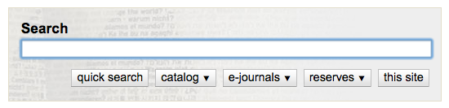
What’s a Discovery Tool?
A user interface for search that sits outside of a library system
Notes:
Provides search to a wide range of library resources, from full text articles to items in a library’s traditional catalog. Also interacts with a library’s integrated library system (ILS) for availability and requests and user account information. Encompeses and involves a lot of library functions and servces -> access, cataloging, instruction, IT, reference

Slide 3




Web-Scale Discovery Tools
Federated Search
Unified Indexes
Notes:
Encore is from Innovative

Slide 4
Databases
Digital Collections
Catalog
Live Search
Discovery
Tool
Query
Federated Search Process
Notes:
For instance, encore has access to EBSCO’s discovery service index

Slide 5
Catalog
Digital Collections
Centralized
Index
Discovery
Tool
Query
Unified Index Search Process
Notes:
Centralized index may include content from publisher, - libraries can add to the index, institutional repositories library's holding information. Metadata is normalized

Slide 6
Who uses the Academic Library?
Students
Professors and Researchers
Everyone else!
Notes:
Explain how beginning students discovery may be more generalized and have a specific goal, one search or google. More advanced students Professors & other Researchers discover stay up to date in field, maintaining awareness, also know more specialized databases. More and more libraries are creating open access institutional repositories, open data repositories, digital collections which have a wider draw than just the members of the institutions community.
Image from https://openclipart.org/detail/244464/blogging-girl

Slide 7
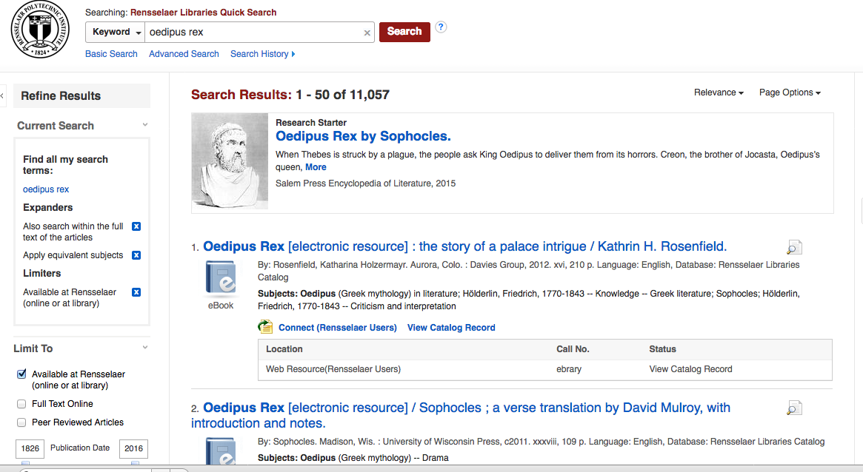
What do We Talk about When We Talk about Discovery?
Known Item Search

Slide 8
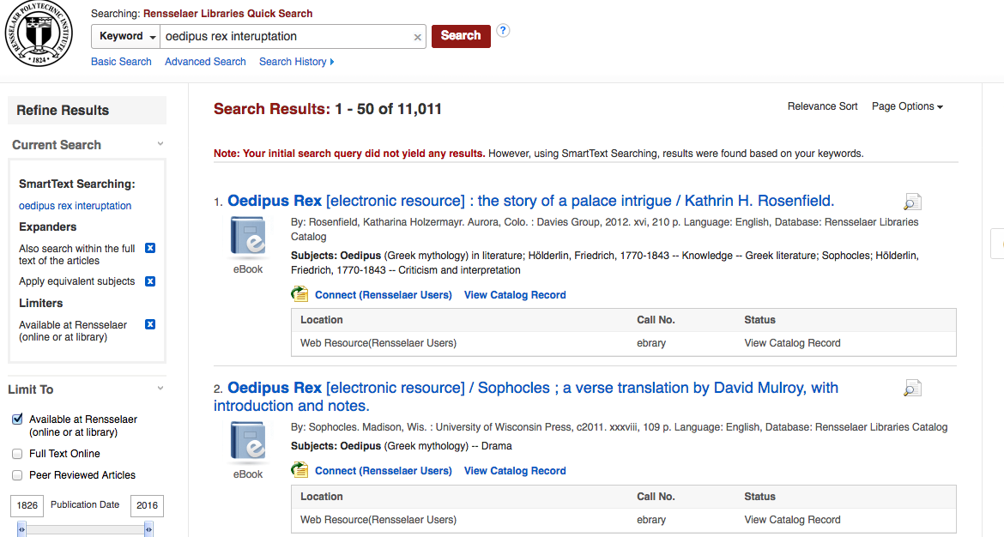
What do We Talk about When We Talk about Discovery?
Exploratory Search

Slide 9
What was Promised?
“The entry of Google into the realm of scholarly information encroaches deeply into territory that librarians once considered their own … Today’s world demands an expansive search environment. The universe of information resources is immense and growing rapidly…Users do not want to jump from one interface to another as they search for information.”
-Branding 2005
Notes:
Marshall Breeding, “Plotting a New Course for Metasearch,” Computers in Libraries25, no.2 (2005): 27–29.

Slide 10
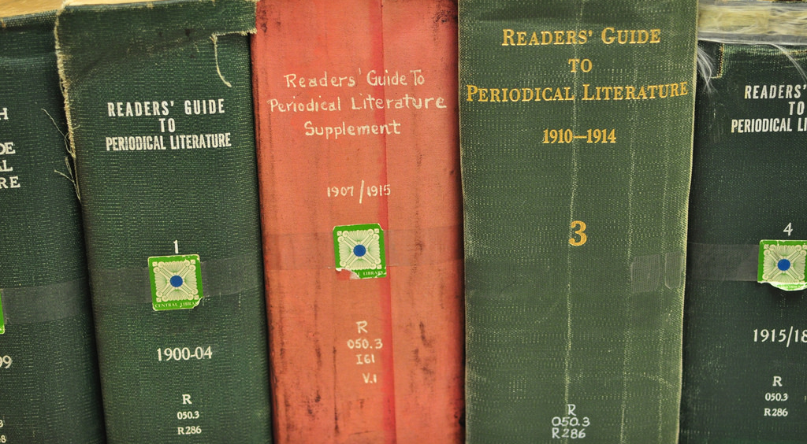
Remember These?
Notes:
In my day …. Also, freshman year of college, google didn’t come into wider user until I was a sophomore, and I remember talking to a computer dude in my dorm room about this new thing called google, and he was like, duh

Slide 11

What about this?

Slide 12
Next Generation Online Catalog
OPAC
All the
Databases
Discovery
Tool
?
Discovery
Tool
Google
Scholar
Notes:
Online Public Library Services > never lived up to potentional, become a method of retrieving locations of resources instead of a way of discovery. In a lot of OPACs, and ILS Keyword search returned results sorted by last in, first out rather than relevance

Slide 13
Purpose and Promise of Discovery Tools?
Single-search box interface
One entry point to a library’s collection, including unseen resources and full text articles
Users have increased efficiency at discovery

Slide 14
By What Criteria are We Judging?
Was the academic library ever the single point of discovery for users?
Does Google provide all the resources of the internet?
Everything is a work in progress

Slide 15
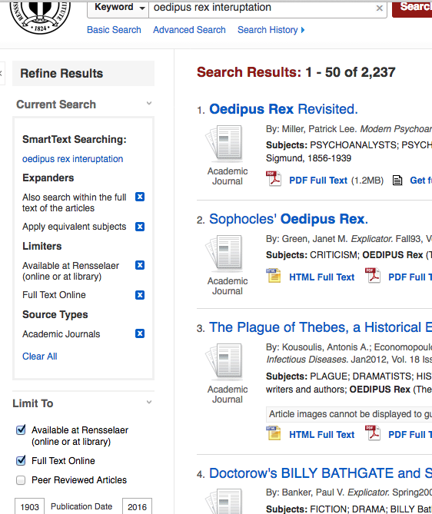
What do Discovery Tool borrow from Librarians?
Configurable Facet Search
Records have rich metadata

Slide 16
What Do Discovery Tools Borrow from Web 2.0?
Enriched Content
Recommendations
Integrate with other library systems and widgets
Social Network Integration
Persistent Links
Visual Search
Autocompletion and spelling recommendations
Email and RSS Alerts to new items
Output options
Notes:
RSS = really simple syndication

Slide 17

What Can Be Improved?
Relevancy
Amount of Content
Integration with local library systems
Availability of Analytics
Notes:
Primo can rank by popularity (clicks and views) , relevancy by citations,
Content tied to licenses and commerical reasons not to share MD with indexes, some specialised databases and other resoruces, like IRs don’t have bibliographic databases that can indexed, open source resources are difficult to find on a mass scale
Integration -> lag time between an action happening in ILS and it being reflected in the discovery tool
More analytics would make it easier for libraries to measure effectiveness of tools and resources in a quantifiable way

Slide 18
What’s Next?
Displaying relationships
Better recommendation tools
Hybrid federated and unified index search?
Linked Data?
Notes:
FRBR
Recommendation right now based on similarity of MARC exlibris has an addon tool that recommends articles based on user patterns from ExLibrires Link Resolver, SFX
Speed & Content of unified index with real time searching of federated
Linked data could integrate more of those specialised resoruces that can be normalized

Slide 19
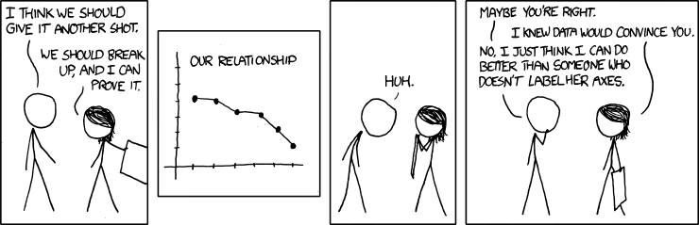
What can academic libraries do?
Assess, analyze and share results
Create pressure groups
Collaborate on Open Source projects

Slide 20
Promise Fulfilled?

Slide 21
Thank you!
andreakathleenbyrne@gmail.com
@andreakbyrne
Find this presentation and the bibliography at https://github.com/andreakb/presentations

